Slide 1
Correlation and Statistical Testing
CS3300 Data Science
RJ Nowling

Slide 2
Correlation and Association
Two variables are correlated (associated) if
knowing the value of one variable
tells you something about
the value of the other variable
Correlation: two numerical variables, sign (- or +) implies direction
Association: one numerical and one categorical variable or two categorical variables. Always positive

Slide 3
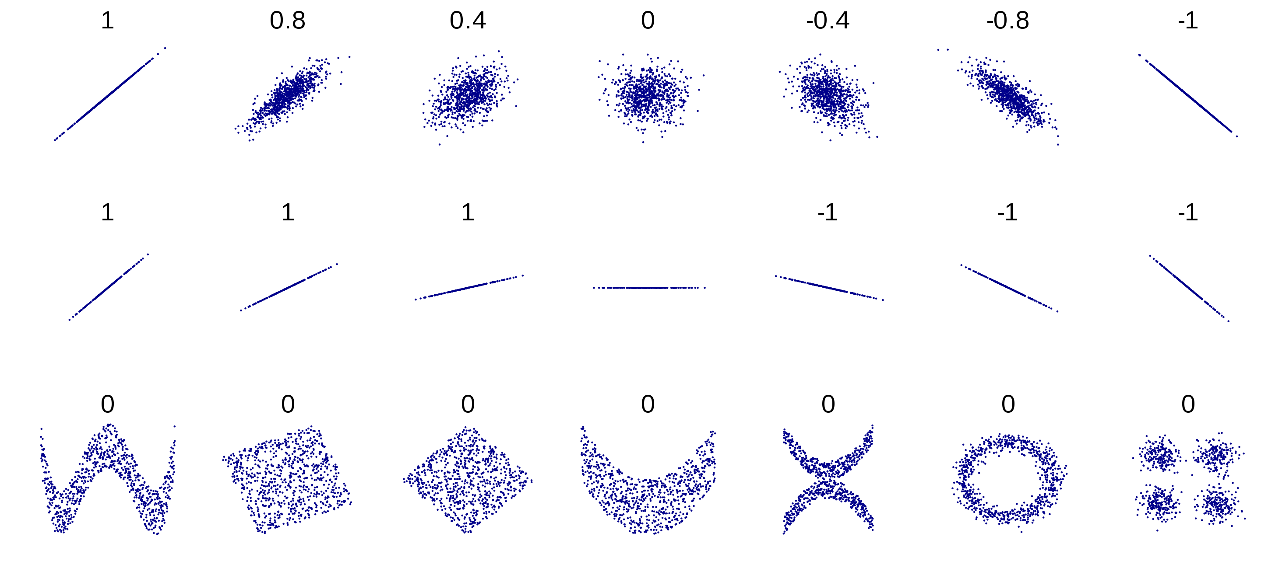
Correlation Between Numerical Variables
https://en.wikipedia.org/wiki/Correlation_and_dependence#/media/File:Correlation_examples2.svg

Slide 4
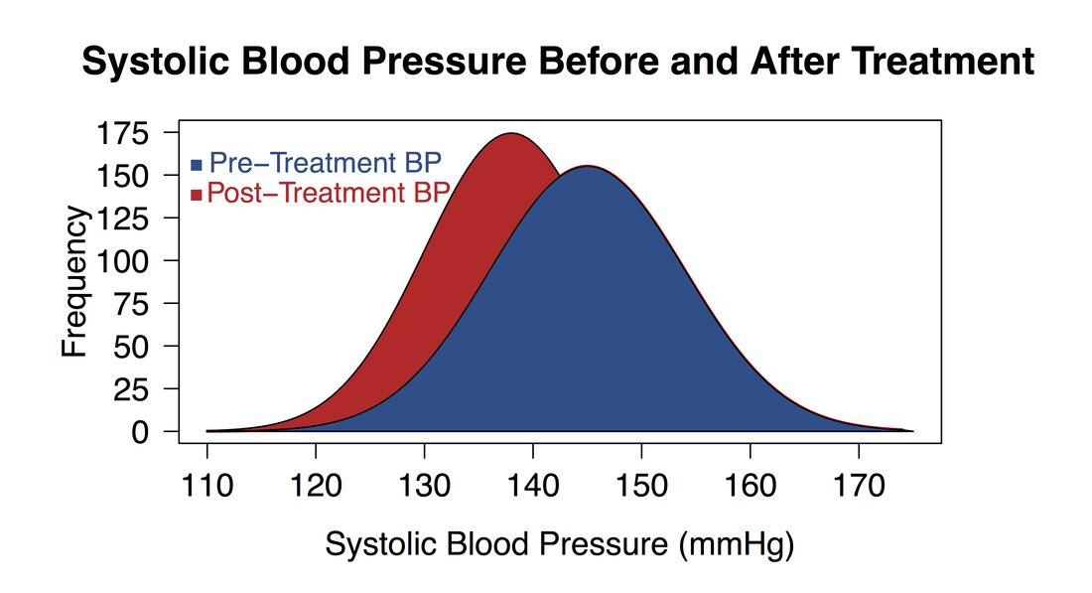
Association: Numerical and Categorical Pair

Slide 5
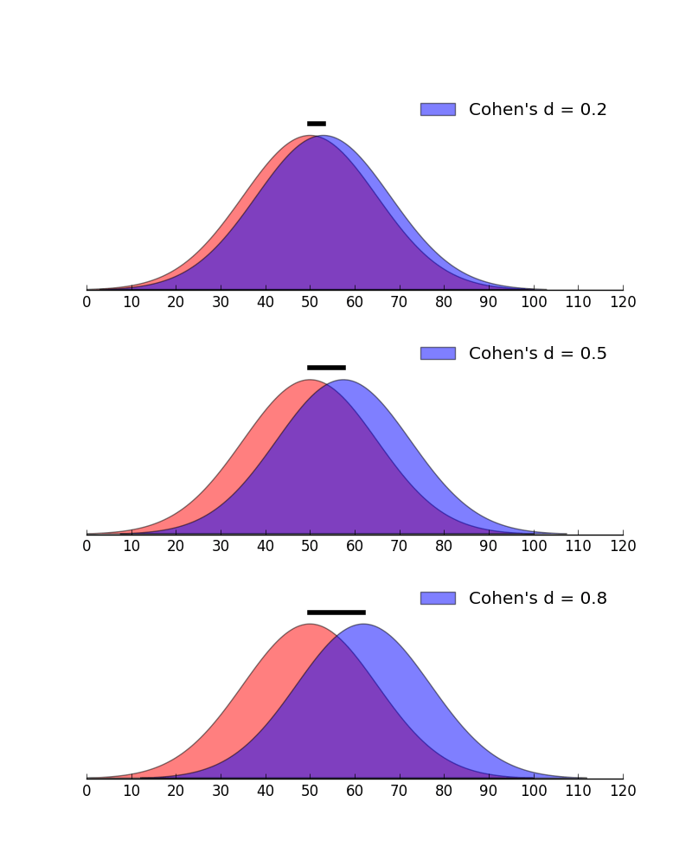
Association: Numerical and Categorical Pair
https://scientificallysound.org/2017/07/27/cohens-d-how-interpretation/

Slide 6
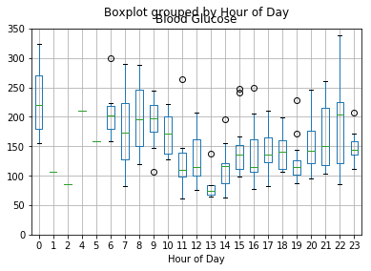
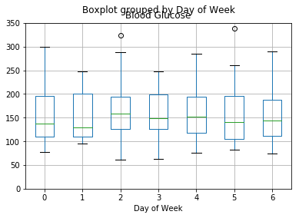
Association: Numerical and Categorical Pair
Associated
Not Associated

Slide 7
Why Care About Correlation?
Help us find relationships between variables
Relationships may provide insights into the data set
E.g., Red Hat makes most of its revenue on support contracts
Red Hat observed that customers were more likely to renew support contracts if customers used the support
Started creating new support services and products to increase the value and encourage customers to use the support services
Choosing variables for machine learning models
Variables correlated with the outcome variable make good features for ML models

Slide 8
Statistical Testing
Statistical testing can be used to assess if there is association between two variables
Are these two dice weighted the same way?
Is height associated with sex?
The stats module of Scipy provides implementations of many common statistical tests

Slide 9
Common Statistical Tests
Numerical — Numerical
Regression / correlation
Boolean — Numerical
Two-Sample T-Test
Categorical — Numerical
ANOVA Test
Krustal-Wallis Test
Categorical — Categorical
𝛘² test of independence
Fisher's Exact Test

Slide 10
Statistical Hypotheses
Null hypothesis: observed data were generated from the same distribution as the control data
Alternative hypothesis: observed data were not generated from the same distribution as the control data
One hypothesis must be true
Both hypotheses cannot be true
Statistical tests are concerned with rejecting the null hypothesis
If we reject the null, then we have to accept the alternative as true

Slide 11
Null Hypotheses
Two-sample T-test
means of the measurement variable are equal for the two categories.
ANOVA
means of the measurement variable are the same for the different categories of data
Chi2 goodness of fit
number of observations in each category is equal to that predicted by a biological theory
Chi2 test of independence
proportions at one variable are the same for different values of the second variable

Slide 12
Quantitatively Measuring Correlation
Measured by the correlation coefficient r(X, Y)
Ranges from -1 to 1
Closer to 1 or -1 means correlated
Closer to 0 means no correlation
A negative value indicates anti-correlation
When one variable goes up, the other goes down

Slide 13
Calculating r²
Assume xs and ys are lists of numerical values
Pearson Correlation Coefficient
r, pvalue = scipy.stats.pearson(xs, ys)
Spearman Correlation Coefficient
r, pvalue = scipy.stats.spearmanr(xs, ys)

Slide 14
Two-Sample T-Test Example
A t-test is appropriate when we are comparing a Boolean — numerical pair
Process:
Divide the samples based on the Boolean variable
Calculate the mean and standard deviation of numerical variable for each group
Estimate normal distribution for numerical variable for each group
Run t-test

Slide 15
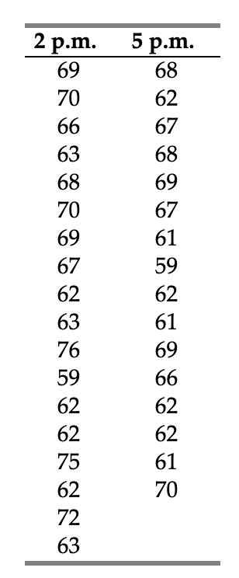
Two-Sample T-Test Example
Question: In fall 2004, students in the 2 p.m. section of my Biological Data Analysis class had an average height of 66.6 inches, while the average height in the 5 p.m. section was 64.6 inches. Are the average heights of the two sections significantly different?

Slide 16
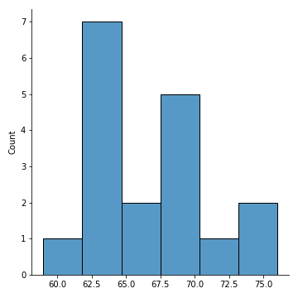
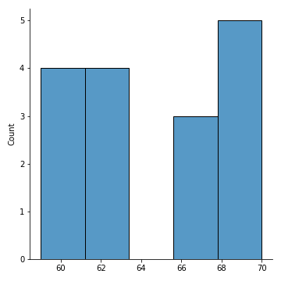
Histograms
2pm Section
5pm Section

Slide 17
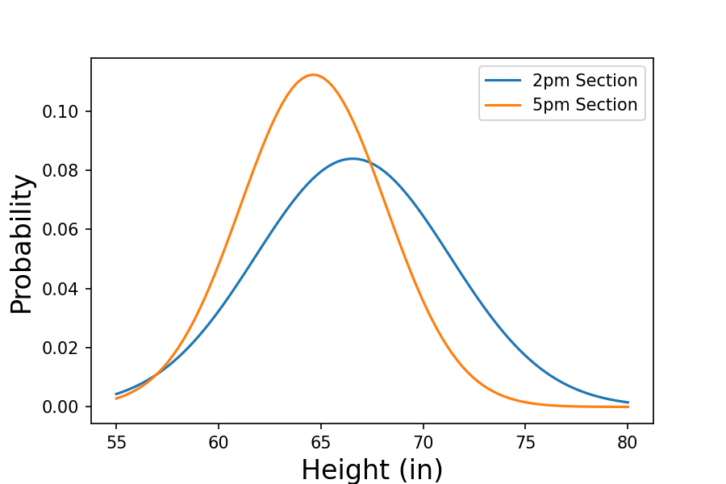
Two-Sample T-Test Example
T-Test starts by estimating the mean and standard deviation of each group
2 pm group:
mean: 66.6
std: 5.8
5 pm group:
mean: 64.6
std: 3.6
Models each group using a Gaussian distribution

Slide 18
Two-Sample T-Test Example
The probability with which one group of samples were generated by the second distribution is well defined for normal distributions
This property is used to calculate the p-value
p-value: 0.21

Slide 19
What is a p-value?
All statistical tests result in a p-value
The p-value gives us the probability that the observed (or more extreme) data were generated from the same probability distribution as the control data
If the p-value < threshold,
then it is unlikely
If the p-value > threshold,
then it is likely
In the t-test example, a p-value of 0.21 means there is no detectable difference in heights between the two sections.

Slide 20
T-Test Caveat
It's assumed the the data are normally distributed
In this example, the data were NOT normally distributed (E.g., the mean was 64.6 but no students had heights between 63 and 65.)
The K-S test can be used for non-normal data at the loss of some power

Slide 21
Statistical Tests for Pairs of Numerical and Categorical Variables
We divide the samples into groups by the value of the categorical variable
Make a list of the value of numerical value for samples in each group
One-way Analysis of Variance (ANOVA)
Tests the null hypothesis that the groups all have the same means stat, pvalue = stats.f_oneway(group1, group2, …)
Kruskal-Wallis
Tests the null hypothesis that the groups all have the same medians stat, pvalue = stats.kruskal(group1, group2, …)

Slide 22
𝛘² Test Example
A 𝛘² (chi-squared) test compares the distributions of values of two categorical variables
Question: Is a 10-sided die weighted or fair?
If the die is fair, we expect all sides to have equal probability of occurring. (A uniform distribution)
If the die is weighted, we expect some sides to occur more often than other sides
I rolled the two dice 10,000 times and recorded how many times each side appeared

Slide 23
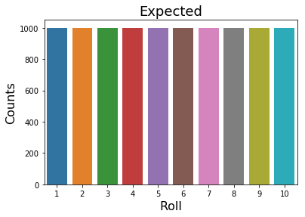
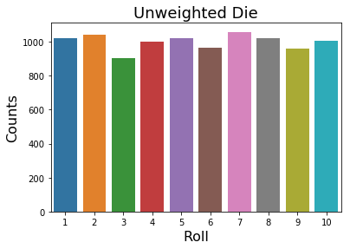
Fair Die

Slide 24
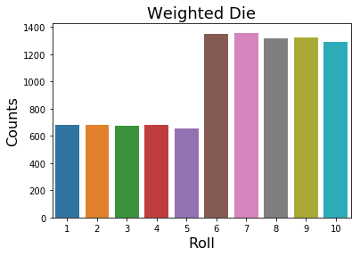
Weighted Die

Slide 25
𝛘² Test
We run a 𝛘² test for each die against the expected distribution: _, fair_pvalue = chisquare(fair_counts, expected_counts) _, weighted_pvalue = chisquare(weighted_counts, expected_counts)

Slide 26
Interpreting 𝛘² Test
The p-value for the fair die is 0.525
The p-value for the weighted die is 4.1e-222
We use a significance level of 0.05. Since 0.525 > 0.05, we accept the null hypothesis that the fair die is sampled from the expected distribution.
Since 4.1e-222 < 0.05, we reject the null hypothesis that the weighted die is sampled from the expected distribution. We accept the alternative hypothesis.

Slide 27
Effect Size
https://scientificallysound.org/2017/07/27/cohens-d-how-interpretation/

Slide 28
Statistical Power
The power of a statistical test is its ability to avoid false positives.
A false positive is when the test indicates something is statistically significant when it shouldn't be
Statistical power depends on the effect size and sample size
More samples = more power = fewer false positives
Fewer samples = less power = more false positives
We can't change the effect size, only the sample size

Slide 29
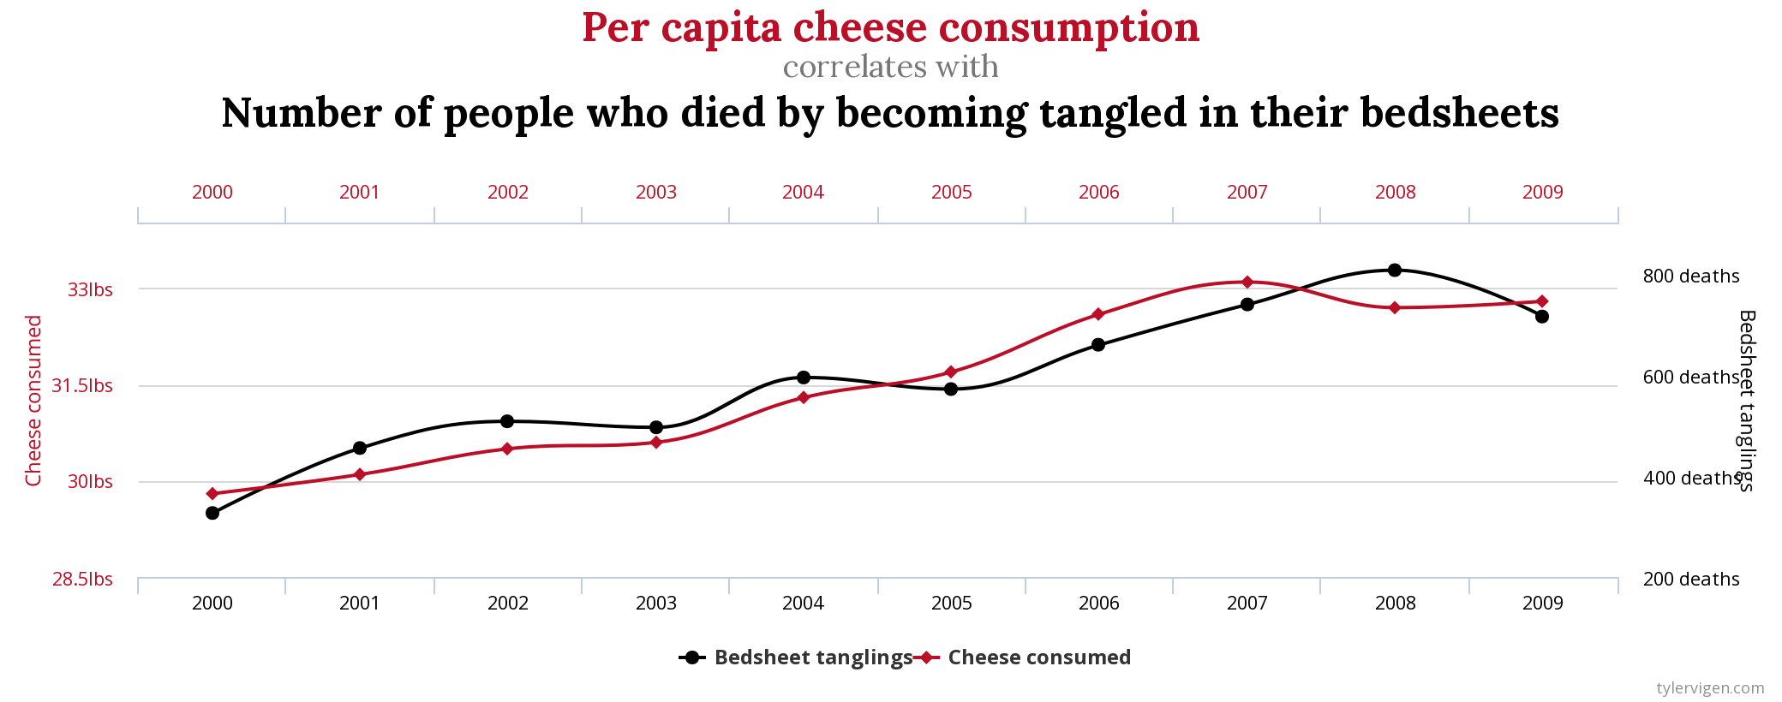
Correlation Does Not Imply Causation!
https://www.tylervigen.com/spurious-correlations

Slide 30
References
The Handbook of Biological Statistics offers clear explanations and examples of many common statistical tests. I frequently use it as a reference guide: http://www.biostathandbook.com/index.html

